Slide 1
Data Exploration
By: Ankush Thakur
Notes:
Hey everyone,
Today, I’ll be walking you through a dataset that looks at housing market trends. We’re focusing on how different factors like Sale Price, Neighborhood, Year Built, and Sale Date interact with each other.
The main goal here is to uncover any significant patterns or unusual trends that could help us make better decisions—whether you’re looking to buy, sell, or just understand the market better.
Let’s dive into the specifics of the data and see what we can find.

Slide 2
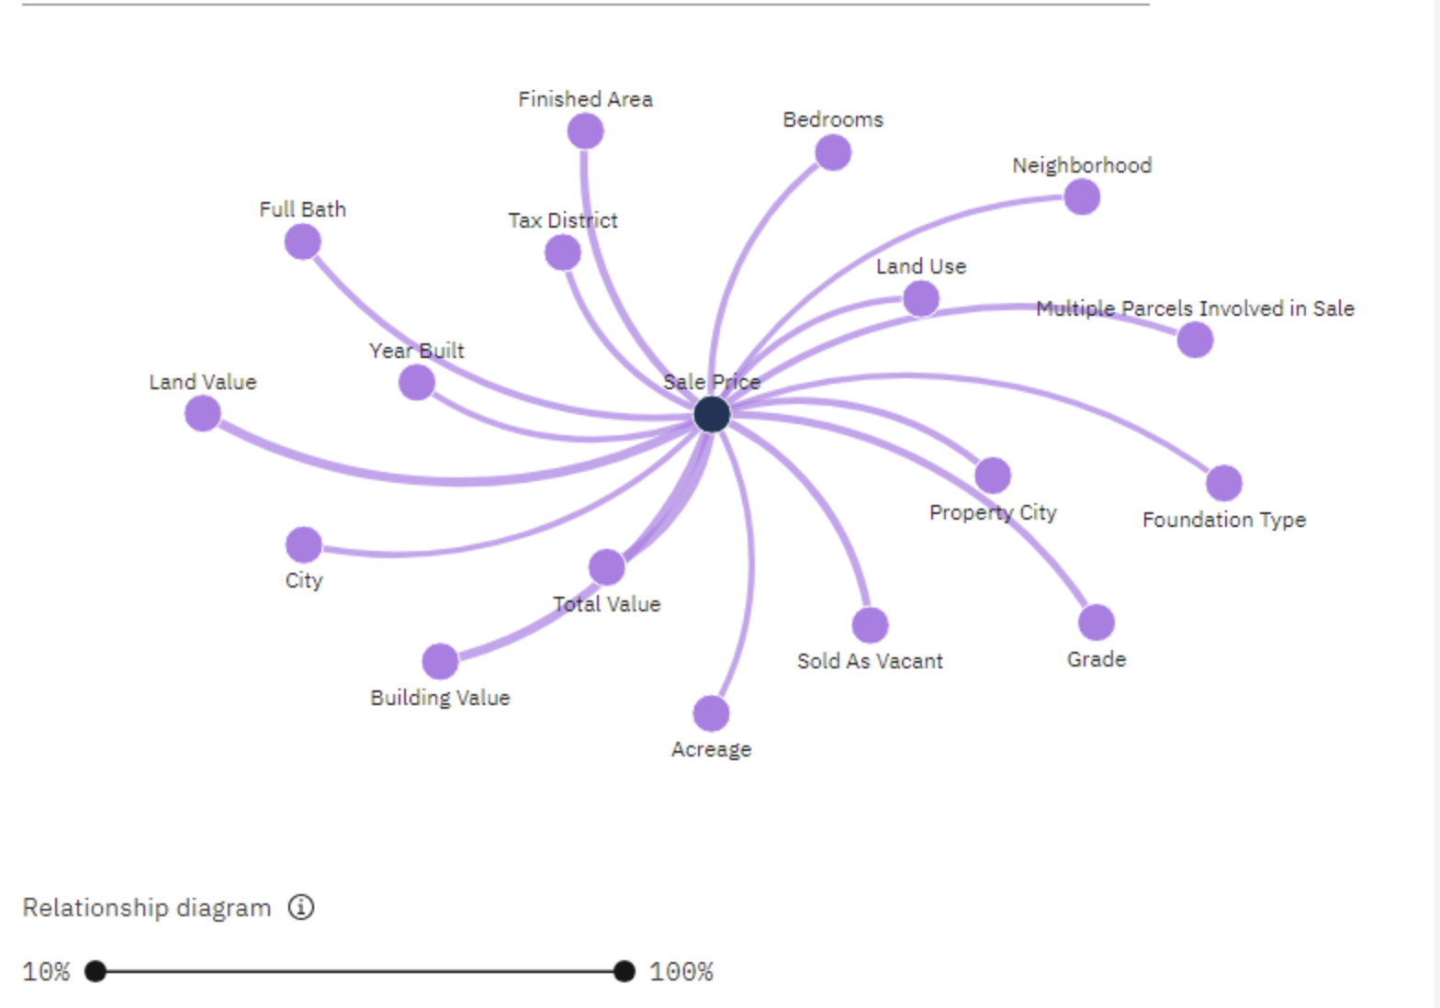
Nature of the Data
Dataset Overview: Real Estate Property Transactions; focus on Sale Price.
Primary Influencers:
Land Value: 33% - Significant due to location and land availability.
Building Value: 30% - Reflects construction costs and quality.
Year Built: 13% - Older properties may have lower prices.
Number of Bedrooms: 16% - Correlates with property utility and family size.
Neighborhood: 12% - Affects desirability and living conditions.
Grade: 23% - Indicates property quality and condition.
Sold as Vacant: 23% - Sale status of the property.
Insights:
Complex Interconnections: Sale price is influenced by multiple factors.
High-Impact Areas: Land and building values, along with property quality, are key.
Market Dynamics: Neighborhood and property grading impact buyer decisions and pricing.
Notes:
So, let’s dive into the nature of our data.
We’re looking at real estate transactions with a focus on Sale Price, which is influenced by several key factors. Land and building values are the biggest contributors, each impacting the Sale Price by a significant percentage. The condition of the property, indicated by factors like the Year Built and its Grade, also plays a crucial role.
For example, land value and building quality together account for over 60% of the influence on Sale Price. Meanwhile, aspects like the number of bedrooms and the neighborhood add additional layers of complexity.
Understanding these factors helps us see how interconnected they are and why Sale Price can vary so much. It’s all about piecing together how these different elements contribute to the final value of a property.

Slide 3
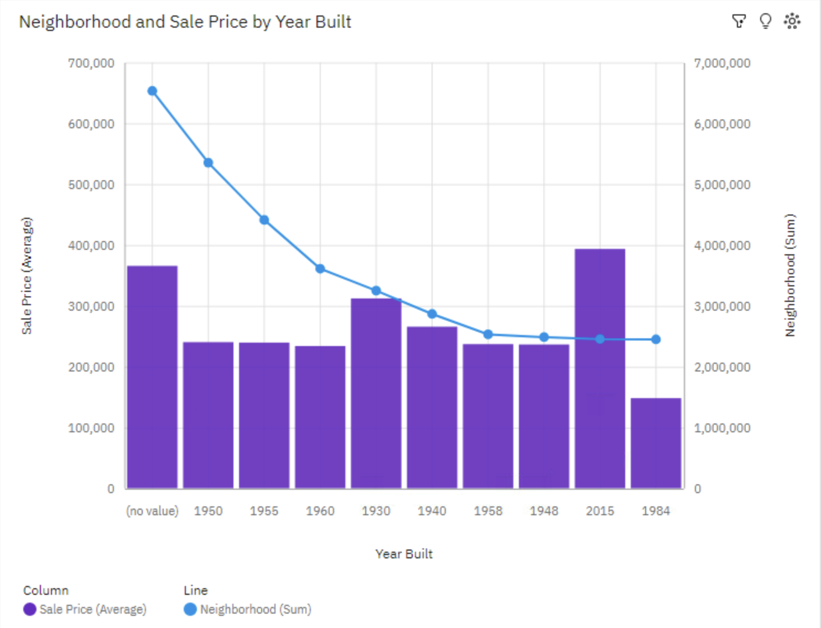
Problem and Decision
Problems Identified
Price Discrepancies:
High Variability in Sale Prices:
Neighborhood 4440 and 4229 show unusually high sale prices.
Neighborhood 6331 has unusually low sale prices.
Year Built 1984: Significant drop in sale prices compared to newer properties.
Missing Data:
Year Built Data Gaps: Missing values suggest high neighborhood values, indicating incomplete records.
Decisions That Can Be Made
Pricing Strategies:
Adjust Pricing Models: Tailor pricing based on neighborhood trends and property age.
Target Market Segmentation: Focus on high-value neighborhoods and adjust for property age.
Data Quality Improvement:
Address Missing Data: Investigate and fill in gaps for Year Built data.
Data Cleaning Initiatives: Regular updates to maintain dataset accuracy.
Investment Decisions:
Focus on High-Value Neighborhoods: Invest in areas with higher average sale prices.
Renovation Decisions: Upgrade properties built in 1984 to boost market value.
Notes:
Alright, let’s talk about the problems we’ve identified and the decisions we can make.
Problems Identified:
Price Discrepancies: We’re seeing a lot of variability in Sale Prices. For instance, neighborhoods like 4440 and 4229 have really high prices, while 6331 has much lower ones. Also, properties built in 1984 are selling for significantly less compared to newer ones, which might indicate issues with those older properties or shifts in market value.
Missing Data: We’ve got some gaps in the Year Built data. These missing values are often linked to unusually high neighborhood values, suggesting our records might be incomplete or inaccurate.
Decisions That Can Be Made:
Pricing Strategies: We need to adjust our pricing models to reflect neighborhood trends and the age of properties. This means differentiating prices based on whether a property is in a high-value neighborhood or how old it is.
Data Quality Improvement: We should focus on fixing missing data issues, particularly with the Year Built field, and keep our data clean and up-to-date to ensure accurate property evaluations.
Investment Decisions: It’s smart to target investments in high-value neighborhoods and consider renovations for older properties to increase their market value.
These steps will help us make more informed decisions and address the issues with our data.

Slide 4
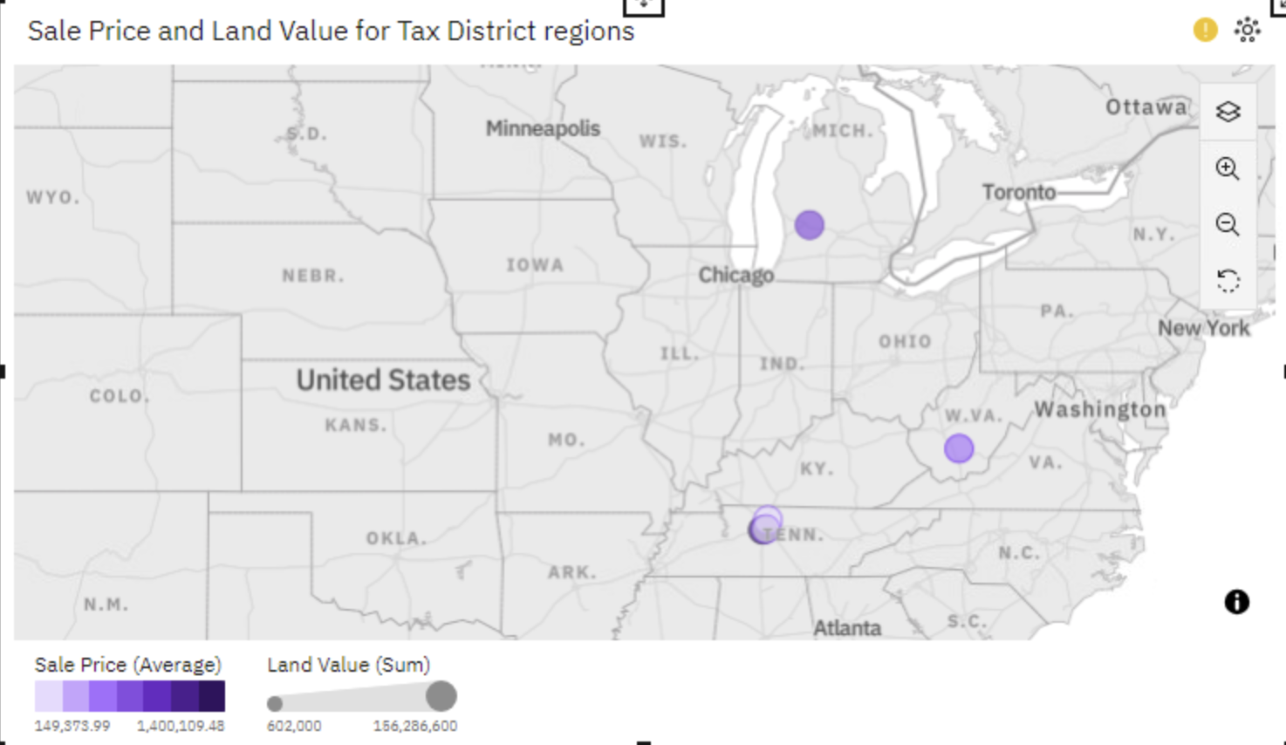
Data Fields and Types
Sale Price: Numeric
Final sale amount of the property.
Land Value: Numeric
Value assigned to the land.
Building Value: Numeric
Value assigned to the building structure.
Year Built: Year
Year the property was constructed.
Number of Bedrooms: Numeric
Total count of bedrooms in the property.
Neighborhood: Categorical
Area code representing the neighborhood.
Grade: Numeric
Rating of the property’s condition.
Sold as Vacant: Categorical
Indicates if the property was sold as vacant (Yes/No).
Foundation Type: Categorical
Type of foundation the property has.
Finished Area: Numeric
Amount of usable space in the property.
Sale Date: Date
Date when the property was sold.
Notes:
Alright, let’s break down the data fields and their types.
Sale Price: This is a numeric value representing the final sale amount of each property.
Land Value: This numeric field shows how much the land alone is worth.
Building Value: Another numeric field that indicates the value of the building on the property.
Year Built: This is recorded as the year the property was constructed.
Number of Bedrooms: This numeric field counts the number of bedrooms in the property.
Neighborhood: This is a categorical field with area codes representing different neighborhoods.
Grade: This numeric field rates the condition of the property.
Sold as Vacant: This categorical field tells us whether the property was sold as vacant (Yes or No).
Foundation Type: Another categorical field that describes the type of foundation the property has.
Finished Area: This numeric field measures the amount of usable space in the property.
Sale Date: This is a date field indicating when the property was sold.
Each of these fields gives us important information about the properties, helping us analyze trends and make informed decisions.

Slide 5
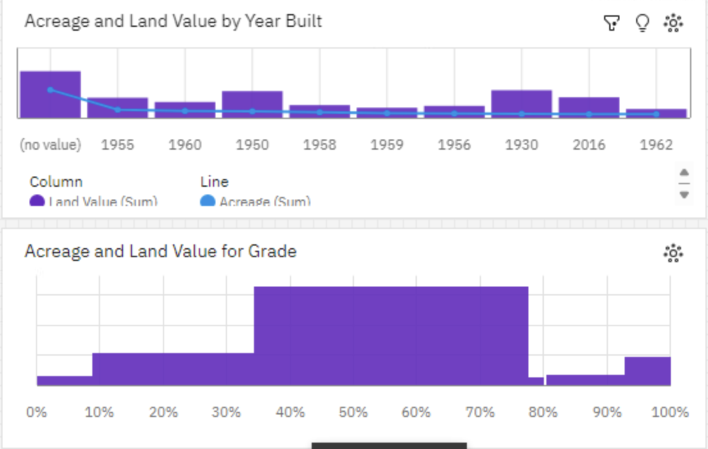
Target Field for Analysis
Target Variable: Sale Price
Importance:
Central to Real Estate Valuation: Sale Price is a key measure of property value.
Influenced by Various Factors: Includes land value, building value, and neighborhood characteristics.
Justification:
High Impact: Sale Price is crucial for decision-making in real estate investments.
Data Correlation: Strong links with variables like land value and building value help us understand property value drivers.
Analysis Plan:
Correlation Analysis: Investigate how Sale Price relates to factors like land value and number of bedrooms.
Trend Analysis: Identify trends in Sale Price over time, especially focusing on Sale Date.
Comparison: Compare average Sale Prices across neighborhoods and construction years.
Notes:
For our analysis, Sale Price is our primary focus:
Importance: Sale Price is central to understanding real estate value. It’s influenced by several factors, including the value of the land, the building, and the neighborhood.
Justification:
High Impact: It’s crucial for making real estate decisions because it directly reflects the property’s market value.
Data Correlation: By examining how Sale Price correlates with other variables like land value and building value, we gain insights into what drives property values.
Analysis Plan:
Correlation Analysis: We’ll look at how Sale Price is related to other factors such as land value and the number of bedrooms.
Trend Analysis: We’ll track trends in Sale Price over time, especially in relation to Sale Date, to see if there are any significant changes.
Comparison: We’ll compare average Sale Prices across different neighborhoods and construction years to identify patterns.
This approach will help us get a clearer picture of what affects Sale Price and how we can use that information for better decision-making.

Slide 6
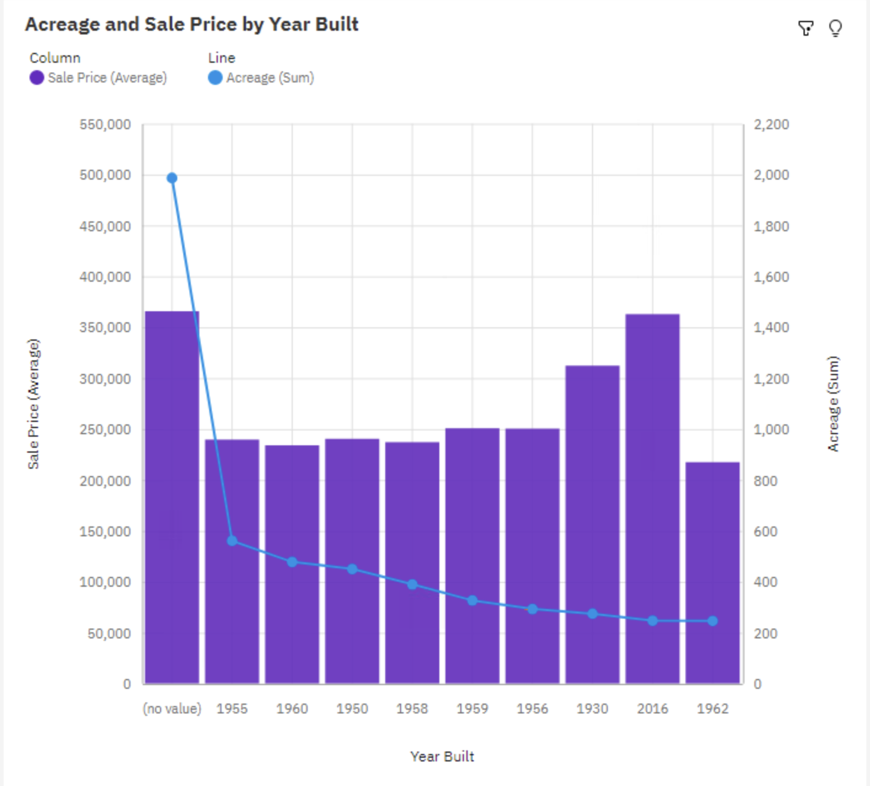
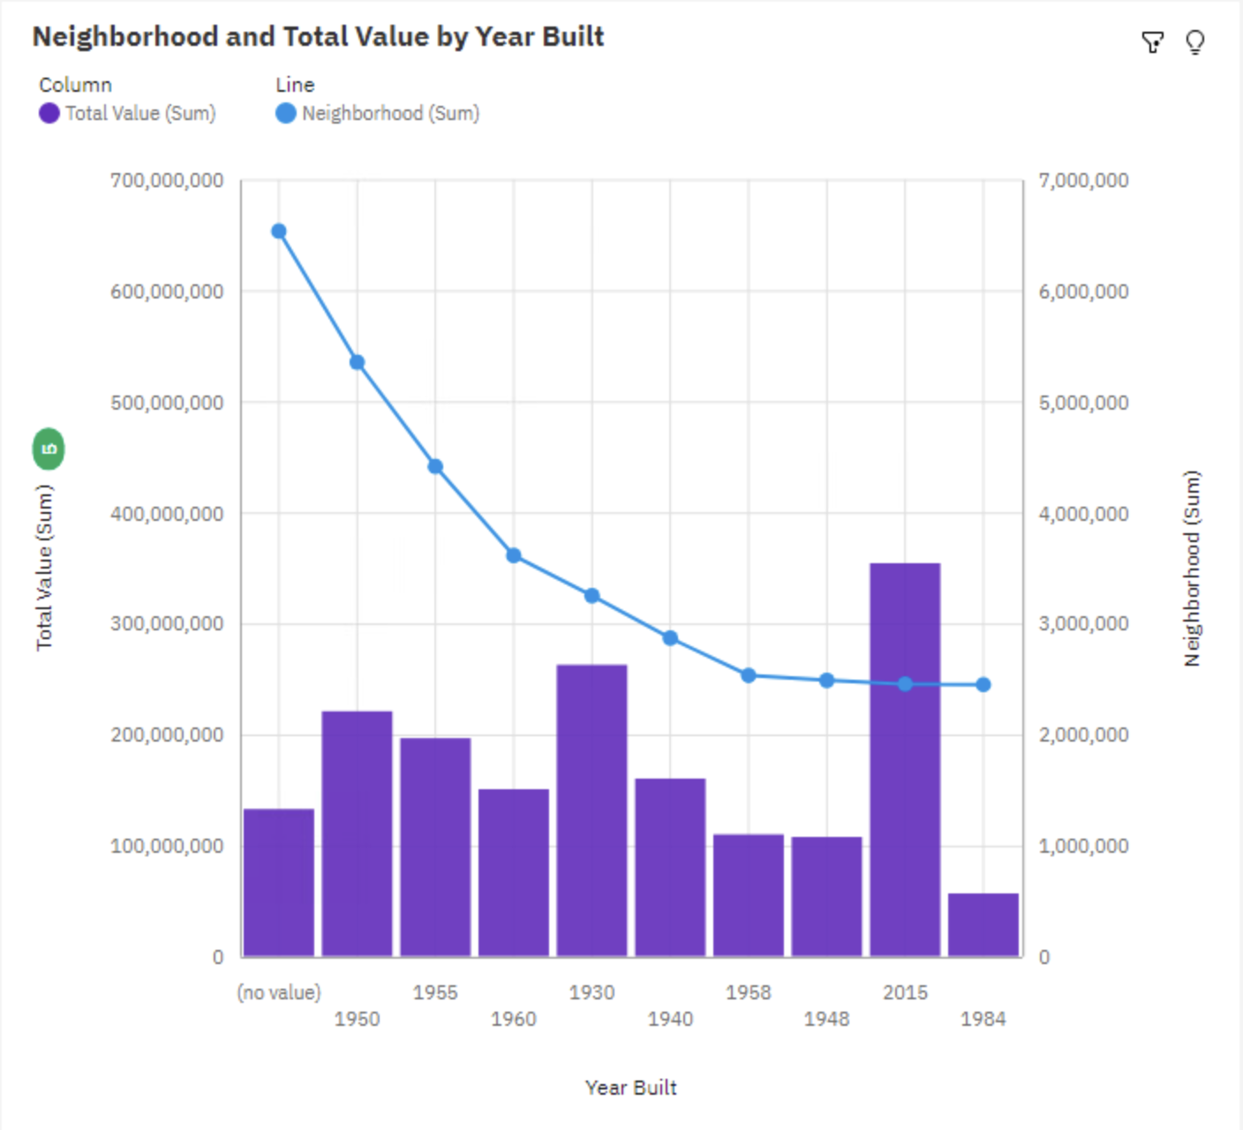
Interesting Visualizations

Slide 7
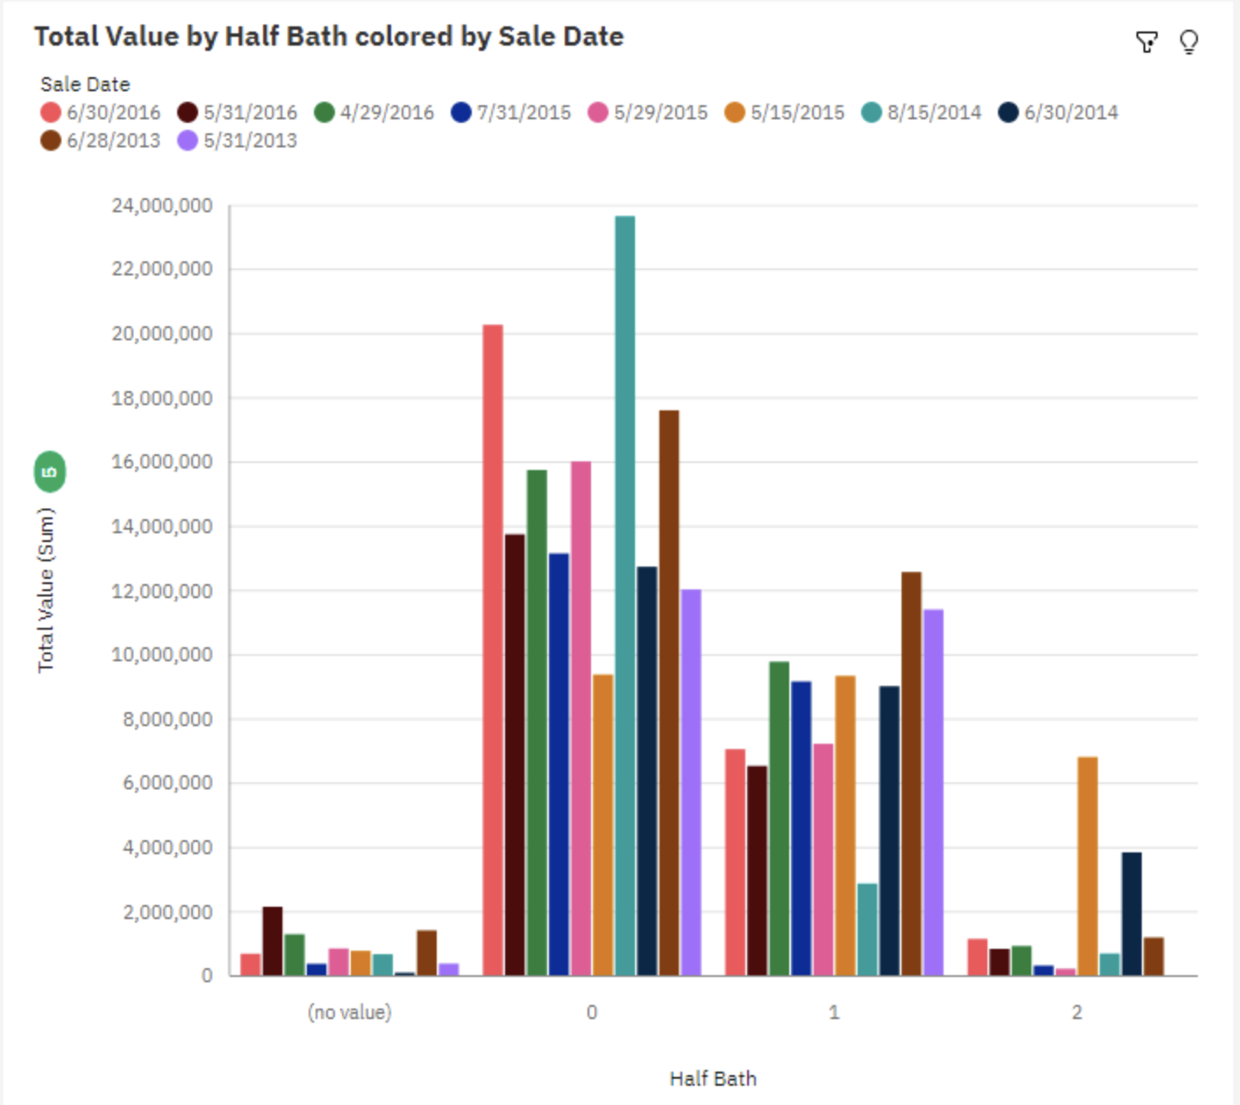
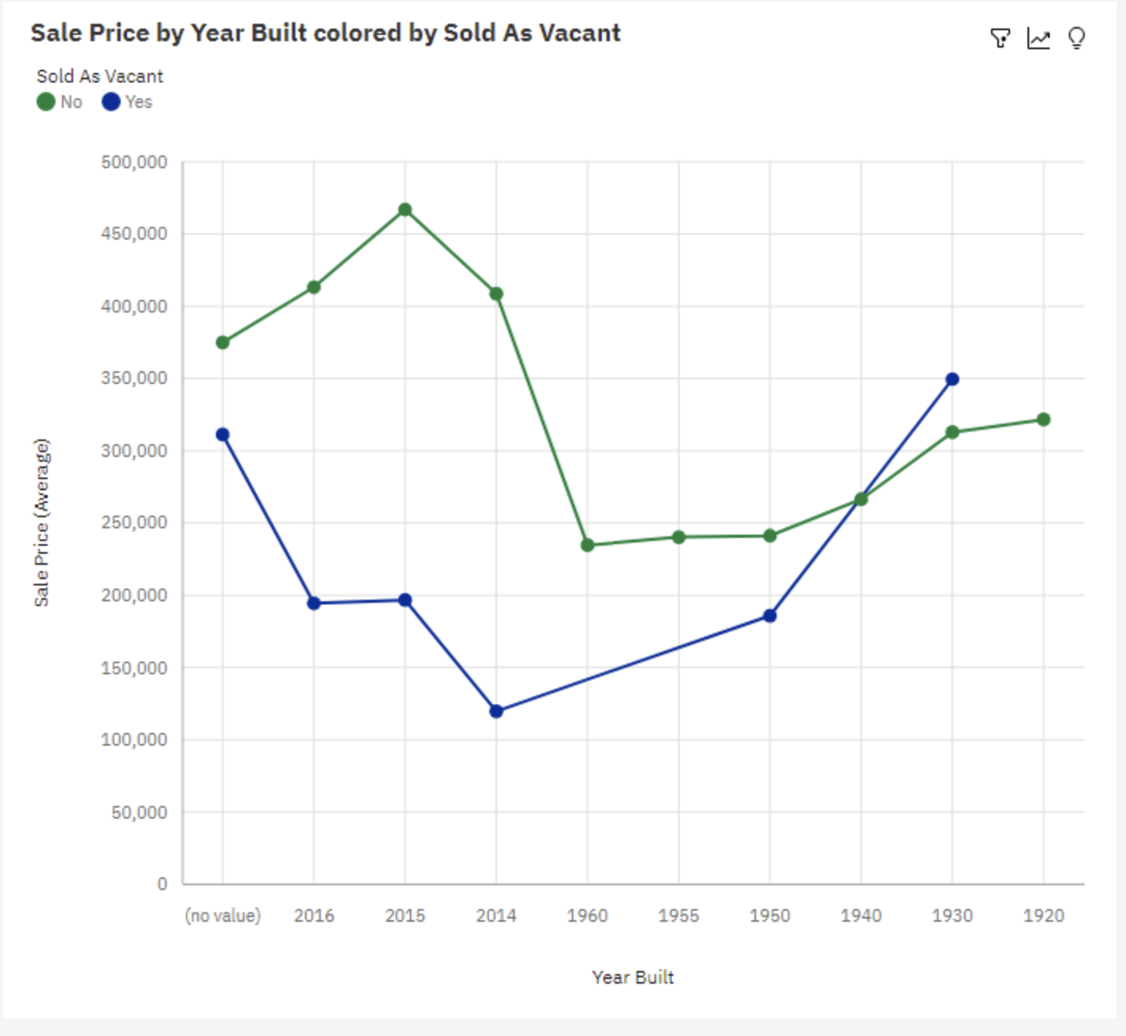
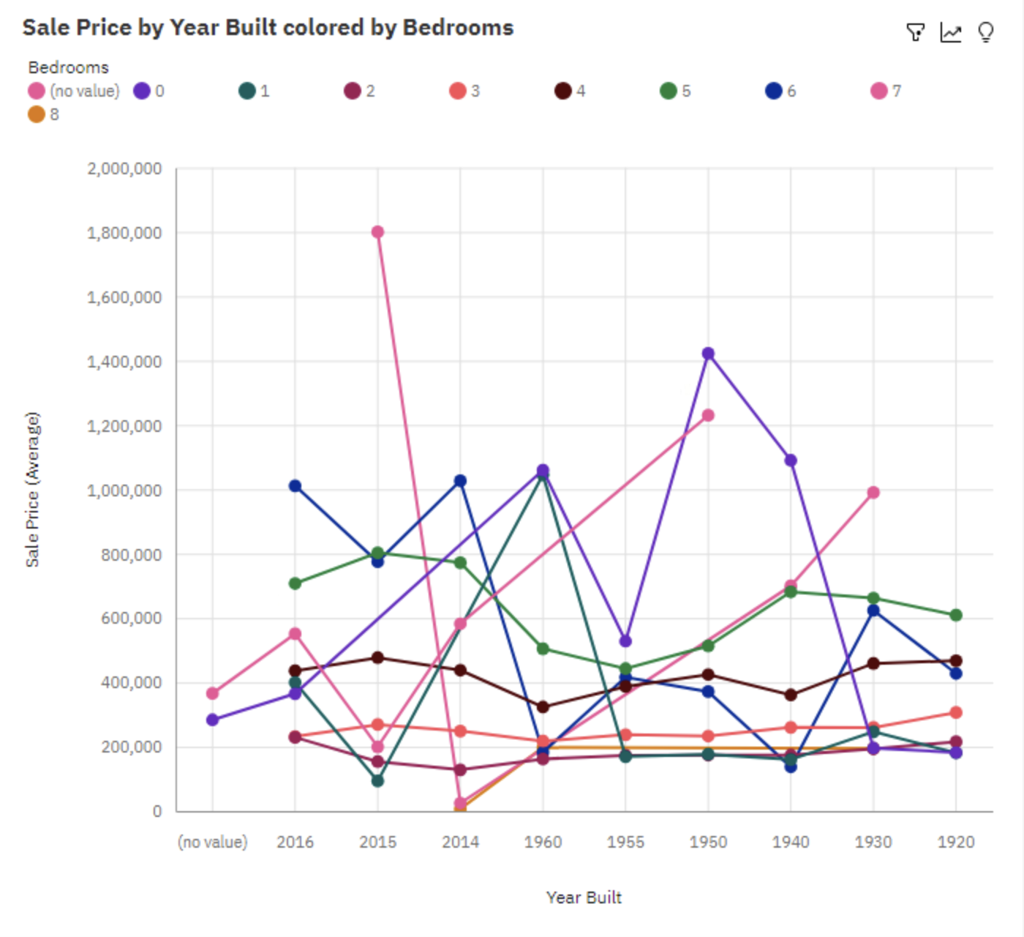
Interesting Visualizations
Notes:
Over all values of Year Built and Bedrooms, the average of Sale Price is almost 353 thousand.

Slide 8
Outliers and Missing Data
Outliers in Sale Price:
December 2014: Sale Price = $8.8 million (Unusually High)
January 2015: Sale Price = $5.1 million
Handling Outliers:
Median Values: Used median values to minimize distortion from extreme values.
Missing Data:
Imputation: Filled in missing Sale Price and Sale Date values where possible.
Exclusions: Removed records where imputation was not feasible.
Impact on Analysis:
Bias Consideration: Acknowledged potential bias introduced by data imputation.
Notes:
### Speaker Notes for Slide 6
---
- **Outliers in Sale Price**: We found some crazy high Sale Prices in December 2014 and January 2015, like $8.8 million and $5.1 million. These are way above the norm, so they could mess up the average and skew our results.
- **Handling Outliers**: To deal with these extreme numbers, we focused on median Sale Prices instead of the average. Medians give a better idea of what's typical since they're not thrown off by the super high values.
- **Missing Data**: We noticed some missing data for Sale Prices and Sale Dates. When possible, we filled in the gaps with estimates, but if we couldn’t, we just left those records out.
- **Impact on Analysis**: Filling in missing data helps keep our dataset more complete, but there’s a chance it could introduce some bias. We kept this in mind when we analyzed the data to make sure our conclusions were solid.

Slide 9
Experience with Assistant
Quick Insights
Used Assistant for instant summaries and visualizations.
Helped quickly spot trends and outliers.
Automated Suggestions
Suggested relevant analyses, such as comparing Sale Prices across neighborhoods and time periods.
Efficiency Boost
Saved time on initial data exploration.
Allowed focus on deeper analysis.
Enhanced Accuracy
Highlighted data inconsistencies.
Ensured final analysis was more accurate and reliable.
Notes:
Using Assistant: I used the Assistant tool during data exploration. It made the process faster and more efficient by giving me quick summaries and visualizations of the data. This was super helpful in spotting trends and outliers right from the start.
Automated Suggestions: One of the best features was the automated suggestions. For example, the Assistant suggested comparing Sale Prices across different neighborhoods and years, which turned out to be really insightful.
Efficiency: By automating these initial analyses, the Assistant saved me a lot of time. I could skip the basic stuff and dive right into more detailed analysis.
Accuracy: The Assistant also pointed out any data inconsistencies. This was great because it helped me clean up the data and make sure my final analysis was accurate.

Slide 10
Conclusion
Key Insights: Identified significant trends in Sale Price related to Neighborhood and Year Built.
Challenges: Noted unusual Sale Price fluctuations on specific dates; Assistant helped spot and address data inconsistencies.
Recommendations: Focus on further analyzing neighborhoods with extreme Sale Price variations for more targeted insights.
Next Steps: Propose deeper exploration into factors influencing Sale Prices, such as economic conditions or housing policies.
Notes:
Key Insights: In conclusion, our analysis revealed some important trends, especially how Sale Price varies significantly depending on the Neighborhood and the Year Built. We saw that certain neighborhoods had much higher or lower prices than average, which could be key areas for further study.
Challenges: We also faced challenges, like unusual price fluctuations on specific dates. This was where the Assistant really helped by spotting these inconsistencies early on, allowing us to address them before diving deeper into the analysis.
Recommendations: Moving forward, I'd recommend focusing on those neighborhoods with extreme price variations. Understanding why these anomalies occur could provide valuable insights for potential buyers or investors.
Next Steps: The next logical step would be to explore other factors that might be influencing Sale Prices, such as changes in economic conditions or housing policies during the analyzed period. This could give us a fuller picture of what's driving the market.

